Slide 1
Perfect Competition
Chapter 20

Slide 2
The Theory of Perfect Competition
Basics: A market structure is a firm’s particular environment, the characteristics of which influence the firm’s pricing and decision making.
Perfect Competition Theory is a theory of market structure.

Slide 3
Perfect Competition Assumptions
There are many sellers and many buyers, none of which is large in relation to total sales or purchases.
Each firm produces and sells a homogeneous product.
Buyers and sellers have all relevant information about prices, product quality, sources of supply, and so forth.
Firms have easy entry and exit.

Slide 4
Perfectly Competitive Firms are Price Takers
A price taker is a seller that does not have the ability to control the price of the product it sells; it takes the price determined in the market.
A firms is restrained from being anything but a price taker if it finds itself one among many firms where its supply is small relative to the total market supply, and it sells a homogeneous product in an environment where buyers and sellers have all relevant information.

Slide 5
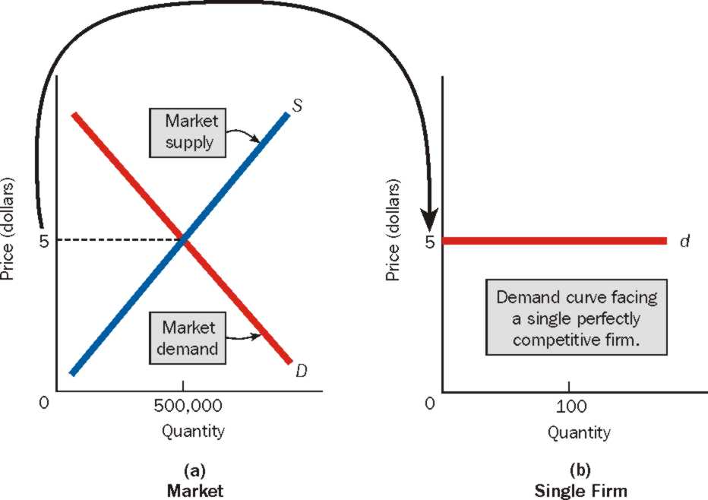
The Demand Curve for a Perfectly Competitive Firm is Horizontal!

Slide 6
The market , composed of all buyers and sellers, establishes the equilibrium price.
When the equilibrium price has been established, a single perfectly competitive firm faces a horizontal demand curve (perfectly elastic) at the equilibrium price. So, the firm is a price taker; it takes the equilibrium price established by the market and sells any and all quantities of output at this price.
If a firm tries to charge a price higher than the equilibrium price, it won’t be able to do so. This is because the firm sells homogeneous product, its supply is small relative to the total market supply, and all the buyers are well informed about where they can obtain the product at the lowest price.

Slide 7
The Marginal Revenue Curve of a Perfectly Competitive Curve is the Same as its Demand Curve
The firm’s marginal revenue is the change in total revenue that results from selling one additional unit of output.
Notice that marginal revenue at any output level is always equal to the equilibrium price. For a perfectly competitive firm, price is equal to marginal revenue.
The marginal revenue curve for the perfectly competitive firm is the same as its demand curve.

Slide 8
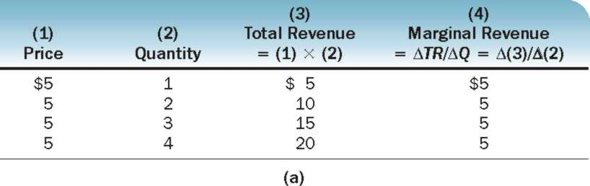
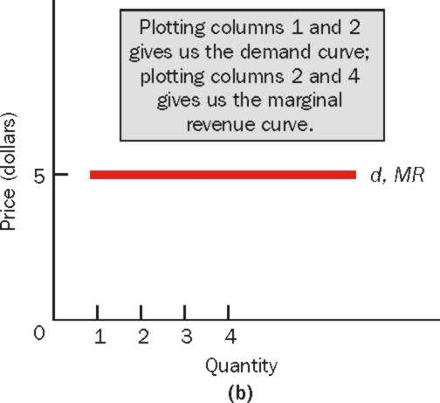
The Demand Curve and the Marginal Revenue Curve for a Perfectly Competitive Firm

Slide 9
Theory and Real World Markets
A market that does not meet the assumptions of perfect competition may nonetheless approximate those assumptions to such a degree that it behaves as if it were a perfectly competitive market. If so, the theory of perfect competition can be used to predict the market’s behavior.
(in reality, the number of sellers may not be large enough for every firm to be a price taker, but the firm’s control over price may be negligible. Similarly buyers may not have all relevant information concerning prices and quality, again it may be negligible)

Slide 10
Perfect Competition in the Short Run
The firm will continue to increase its quantity of output as long as marginal revenue is greater than marginal cost.
The firm will stop increasing its quantity of output when marginal revenue and marginal cost are equal
The Profit – Maximization Rule: Produce the quantity of output at which MR=MC
In perfect competition, P = MR = MC

Slide 11
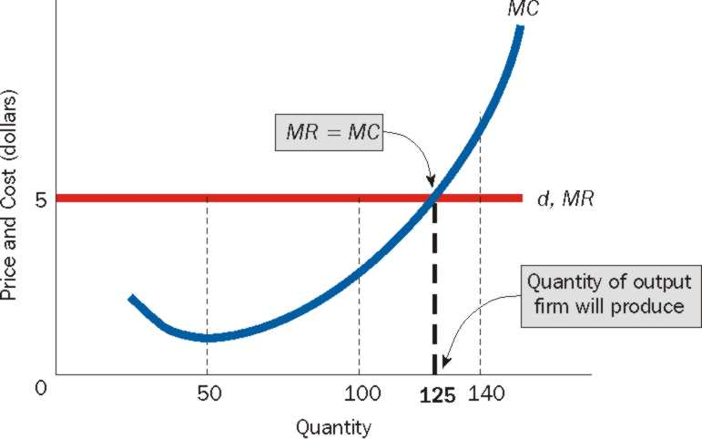
The Quantity of Output the Perfectly Competitive Firm Will Produce
The firm’s demand curve is horizontal at the equilibrium price. Its demand curve is its marginal revenue curve. The firm produces that quantity of output at which MR=MC

Slide 12
Allocative efficiency and perfect competition
Resource Allocative Efficiency: the situation occurs when produce the quantity of output at which price equals marginal cost: P = MC.
Producing a good until price equals marginal cost ensures that all units of the good are produced that are of greater value to buyers than the alternative goods that might have been produced. (example)

Slide 13
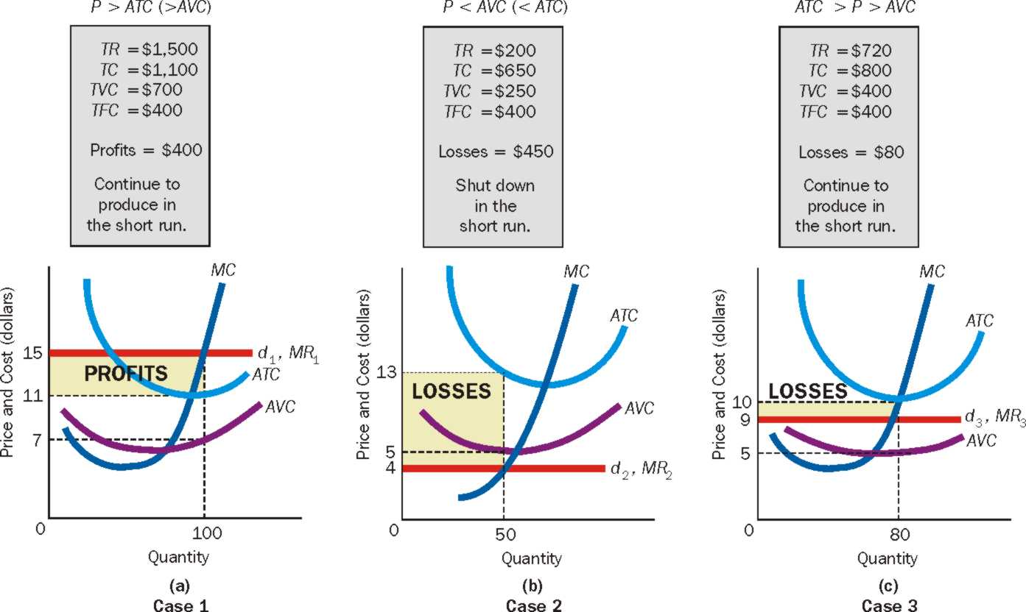
Profit Maximization and Loss Minimization for the Perfectly Competitive Firm: Three Cases

Slide 14
Profit Maximization and Loss Minimization for Perfect Competition
A firm produces in the short run as long as price is above average variable cost.
A firm shuts down in the short run if price is less than average variable cost.
A firm produces in the short run as long as total revenue is greater than total variable costs.
A firm shuts down in the short run if total revenue is less than total variable costs.

Slide 15
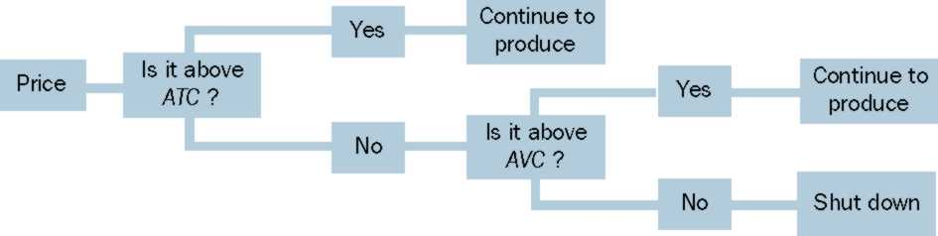
What Should a Firm Do in the Short Run?
The firm should produce in the short run as long as price (P) is above average variable cost (AVC). It should shut down in the short run if price is below average variable cost.

Slide 16
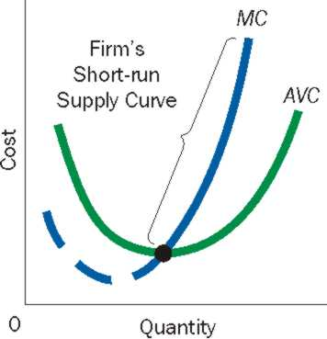
Perfectly Competitive Firm’s Short-Run Supply Curve
Only a price above average variable cost will induce the firm to supply output.
The Short-Run supply curve is that portion of the firm’s marginal cost curve that lies above the average variable cost curve.

Slide 17
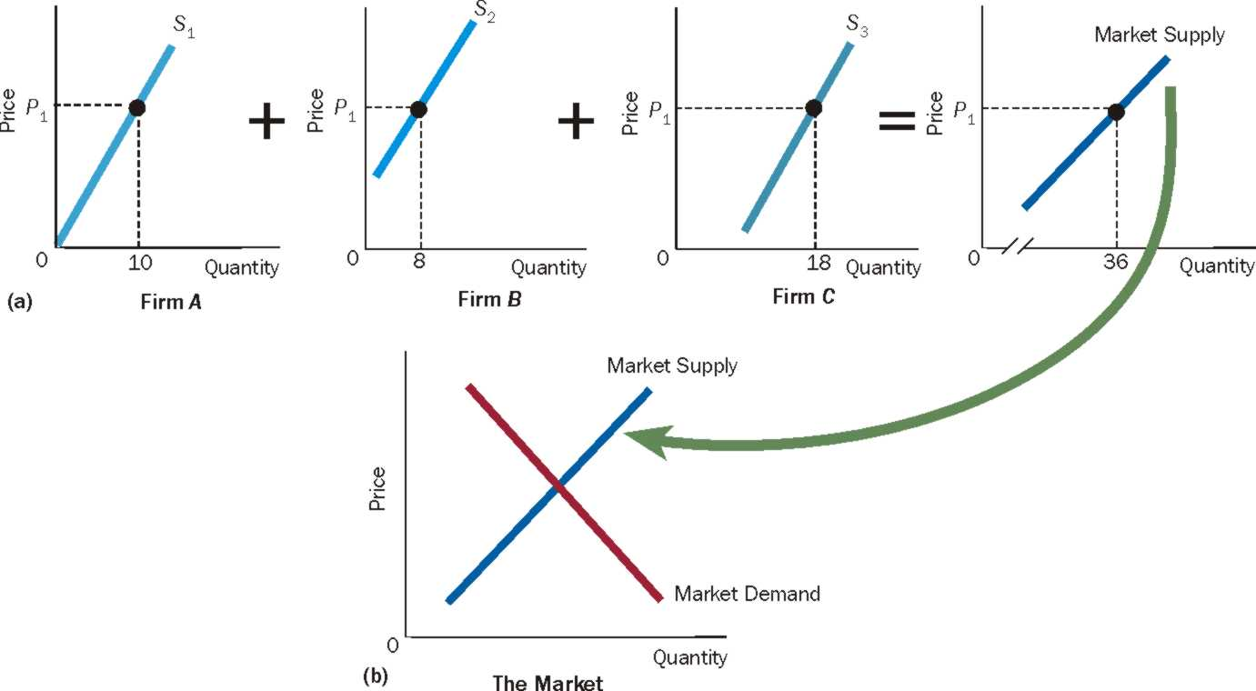
Deriving the Market (Industry) Supply Curve

Slide 18
Perfect Competition In The Long Run
The following conditions characterize long run equilibrium:
Economic profit is Zero: Price is equal to short-run average total cost (SRATC).
If P > SRATC → positive economic profit → entry
If P < SRATC → loss → exit
2. Firms are producing the quantity of output at which Price is equal to Marginal Cost (MC) or MR=MC
3. No firm has an incentive to change its plant size to produce its current output; that is, SRATC=LRATC at the quantity of output at which P=MC. (if SRATC > LRATC then firm has an incentive to change the plant size)

Slide 19
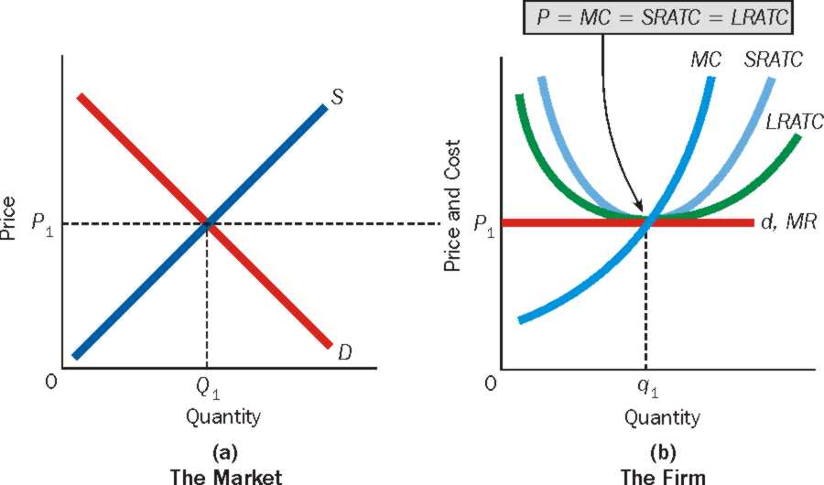
Long-Run Competitive Equilibrium

Slide 20
Long Run Competitive Equilibrium Exists When The Following Occur
There is no incentive for firms to enter or exit the industry
There is no incentive for firms to produce more or less output.
There is no incentive for firms to change plant size.
Condition: P = MC = SRATC = LRATC.

Slide 21
Resource Allocative Efficiency and Productive Efficiency
A firm that produces its output at the lowest possible per unit cost is said to exhibit productive efficiency. The perfectly competitive firm does this in long run equilibrium. Productive efficiency is desirable from society’s standpoint because it means that perfectly competitive firms are economizing on society’s scarce resources and therefore not wasting them.
A firm that produces the quantity of output at which Price = Marginal Cost is said to exhibit resource allocative efficiency.

Slide 22
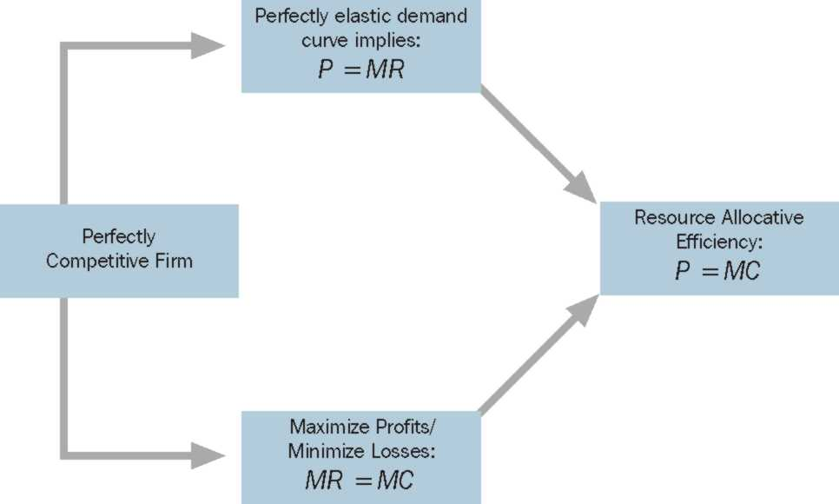
The Perfectly Competitive Firm and Resource Allocative Efficiency
For the perfectly competitive firm, P=MR. Also, the firm maximizes profits or minimizes losses by producing that quantity of output at which MR=MC.
Because P=MR and MR=MC, it follows that P=MC, that is the perfectly competitive firm exhibits resource allocative efficiency.

